Slide 1

Chordinator
Benjamin Chase, Logan Hurney, Ethan Justice
Notes:
(Intended majors are on the next slide)

Slide 2
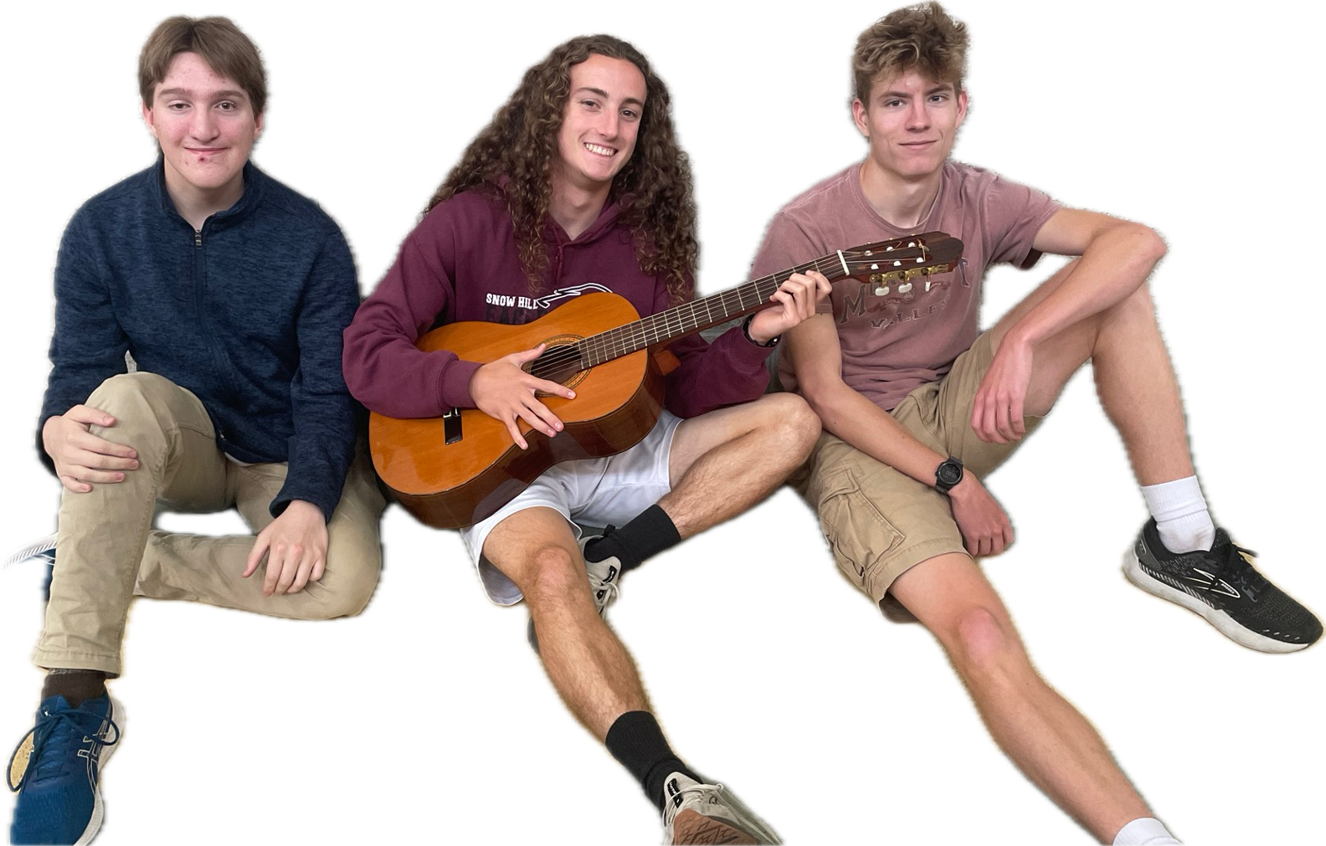
Meet the Designers
Notes:
Intended majors
Ethan:
Logan:
Benny: Undecided, but likely engineering or computer science related

Slide 3
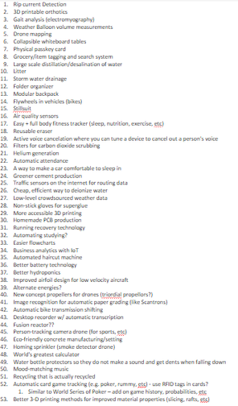
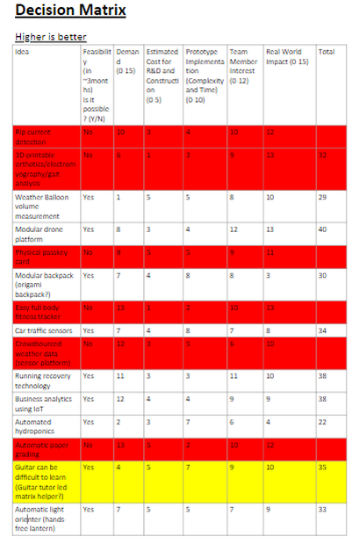
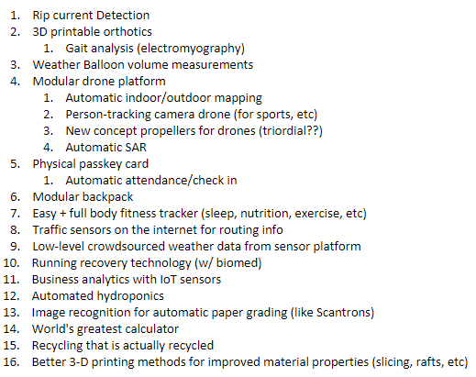

Finding a Problem
Narrowing down issues
Decision Matrix
Brainstorming - Many Ideas and Issues to Solve
Notes:
Initially, we had many ideas for which problems to solve. In fact, we had over 50 ideas for problems to solve and inventions to make.
To narrow down this list, we took out ideas that would not impact enough people or were not feasible for this class.
After that, we made a decision matrix, which is a chart where ideas are ranked based on certain criteria they should fulfill. Criteria included demand, real world impact, and feasibility.
From the decision matrix, we found that making learning to play guitar easier would have a high real-world impact, and could be designed and constructed effectively within our semester.

Slide 4
90%
of beginners learning guitar give up within the first year
Source: MusicRadar/Fender, 2019
Notes:
According to Fender, the leading guitar manufacturer, 90% of people who start learning guitar quit within the first year of playing.
We believe that this stems from the lack of gratification and the immense difficulty of learning to play the guitar well and memorizing chords.

Slide 5
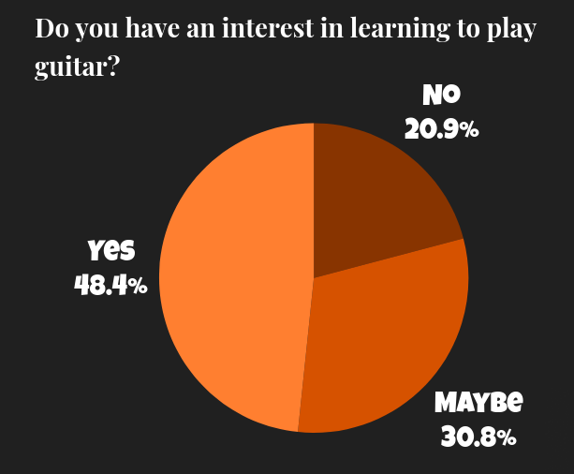
Notes:
To determine whether this problem was really worth solving, we needed to pinpoint the actual issue.
So, we surveyed 207 individuals about their interest in learning guitar and found that nearly 50 % have an interest in learning to play guitar.

Slide 6
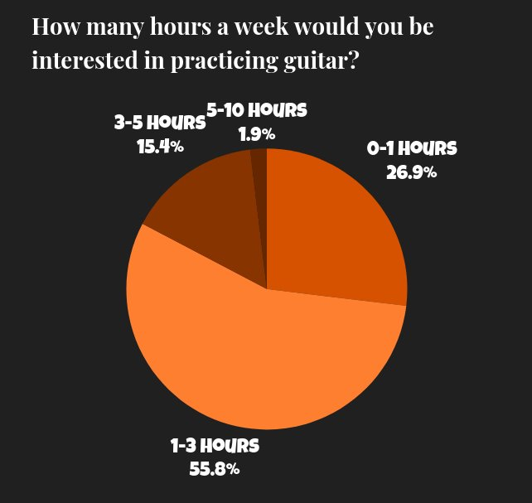
Notes:
However, over 80 % would spend less than three hours per week practicing.

Slide 7
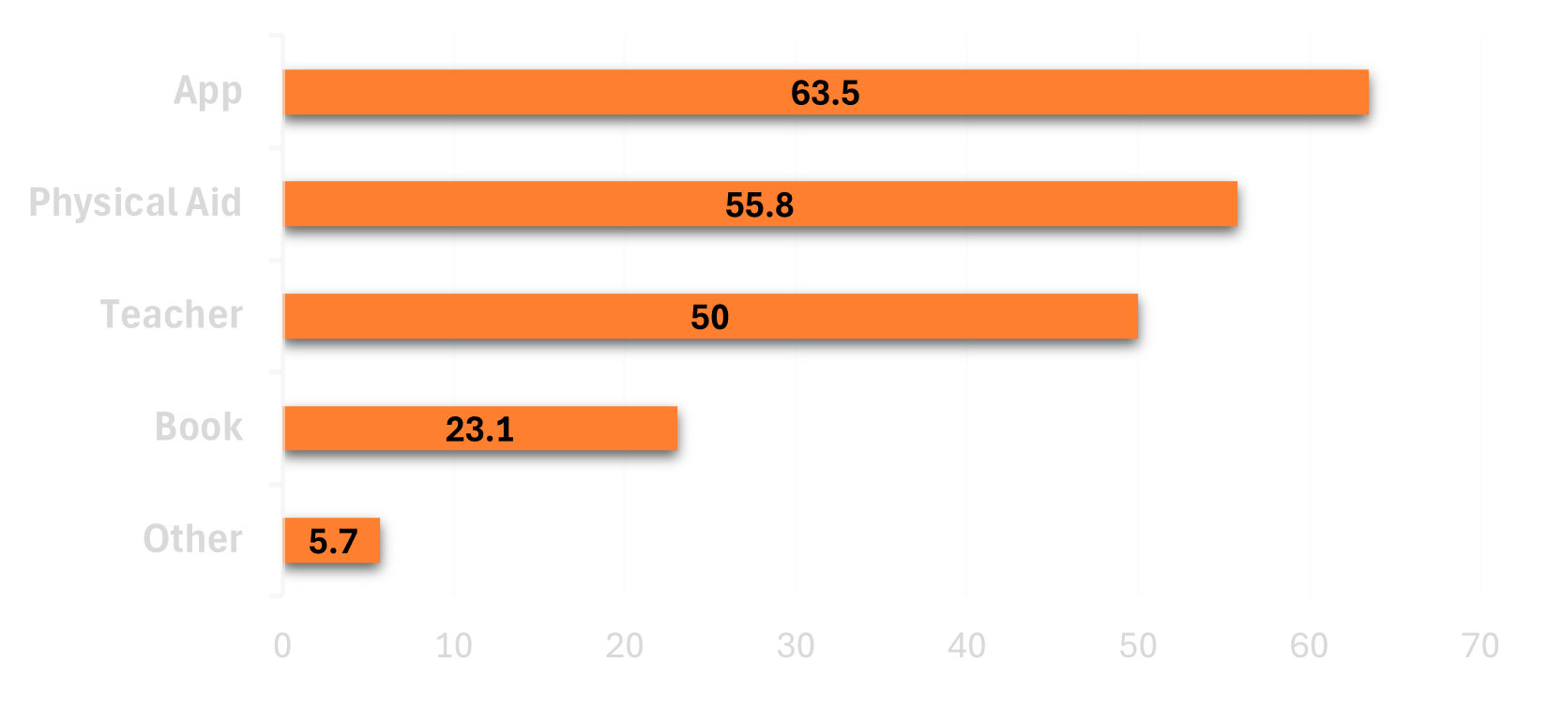
What type of aid(s) would you be interested in using?
Percentage of respondents interested in playing guitar
Notes:
In our survey, we found that 55.8 % of people interested in playing guitar would use a physical aid when learning guitar.

Slide 8
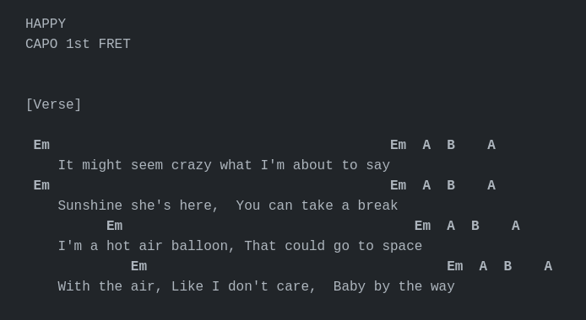
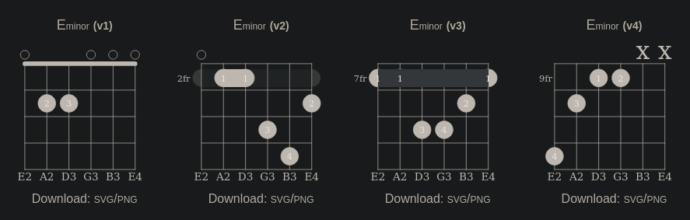
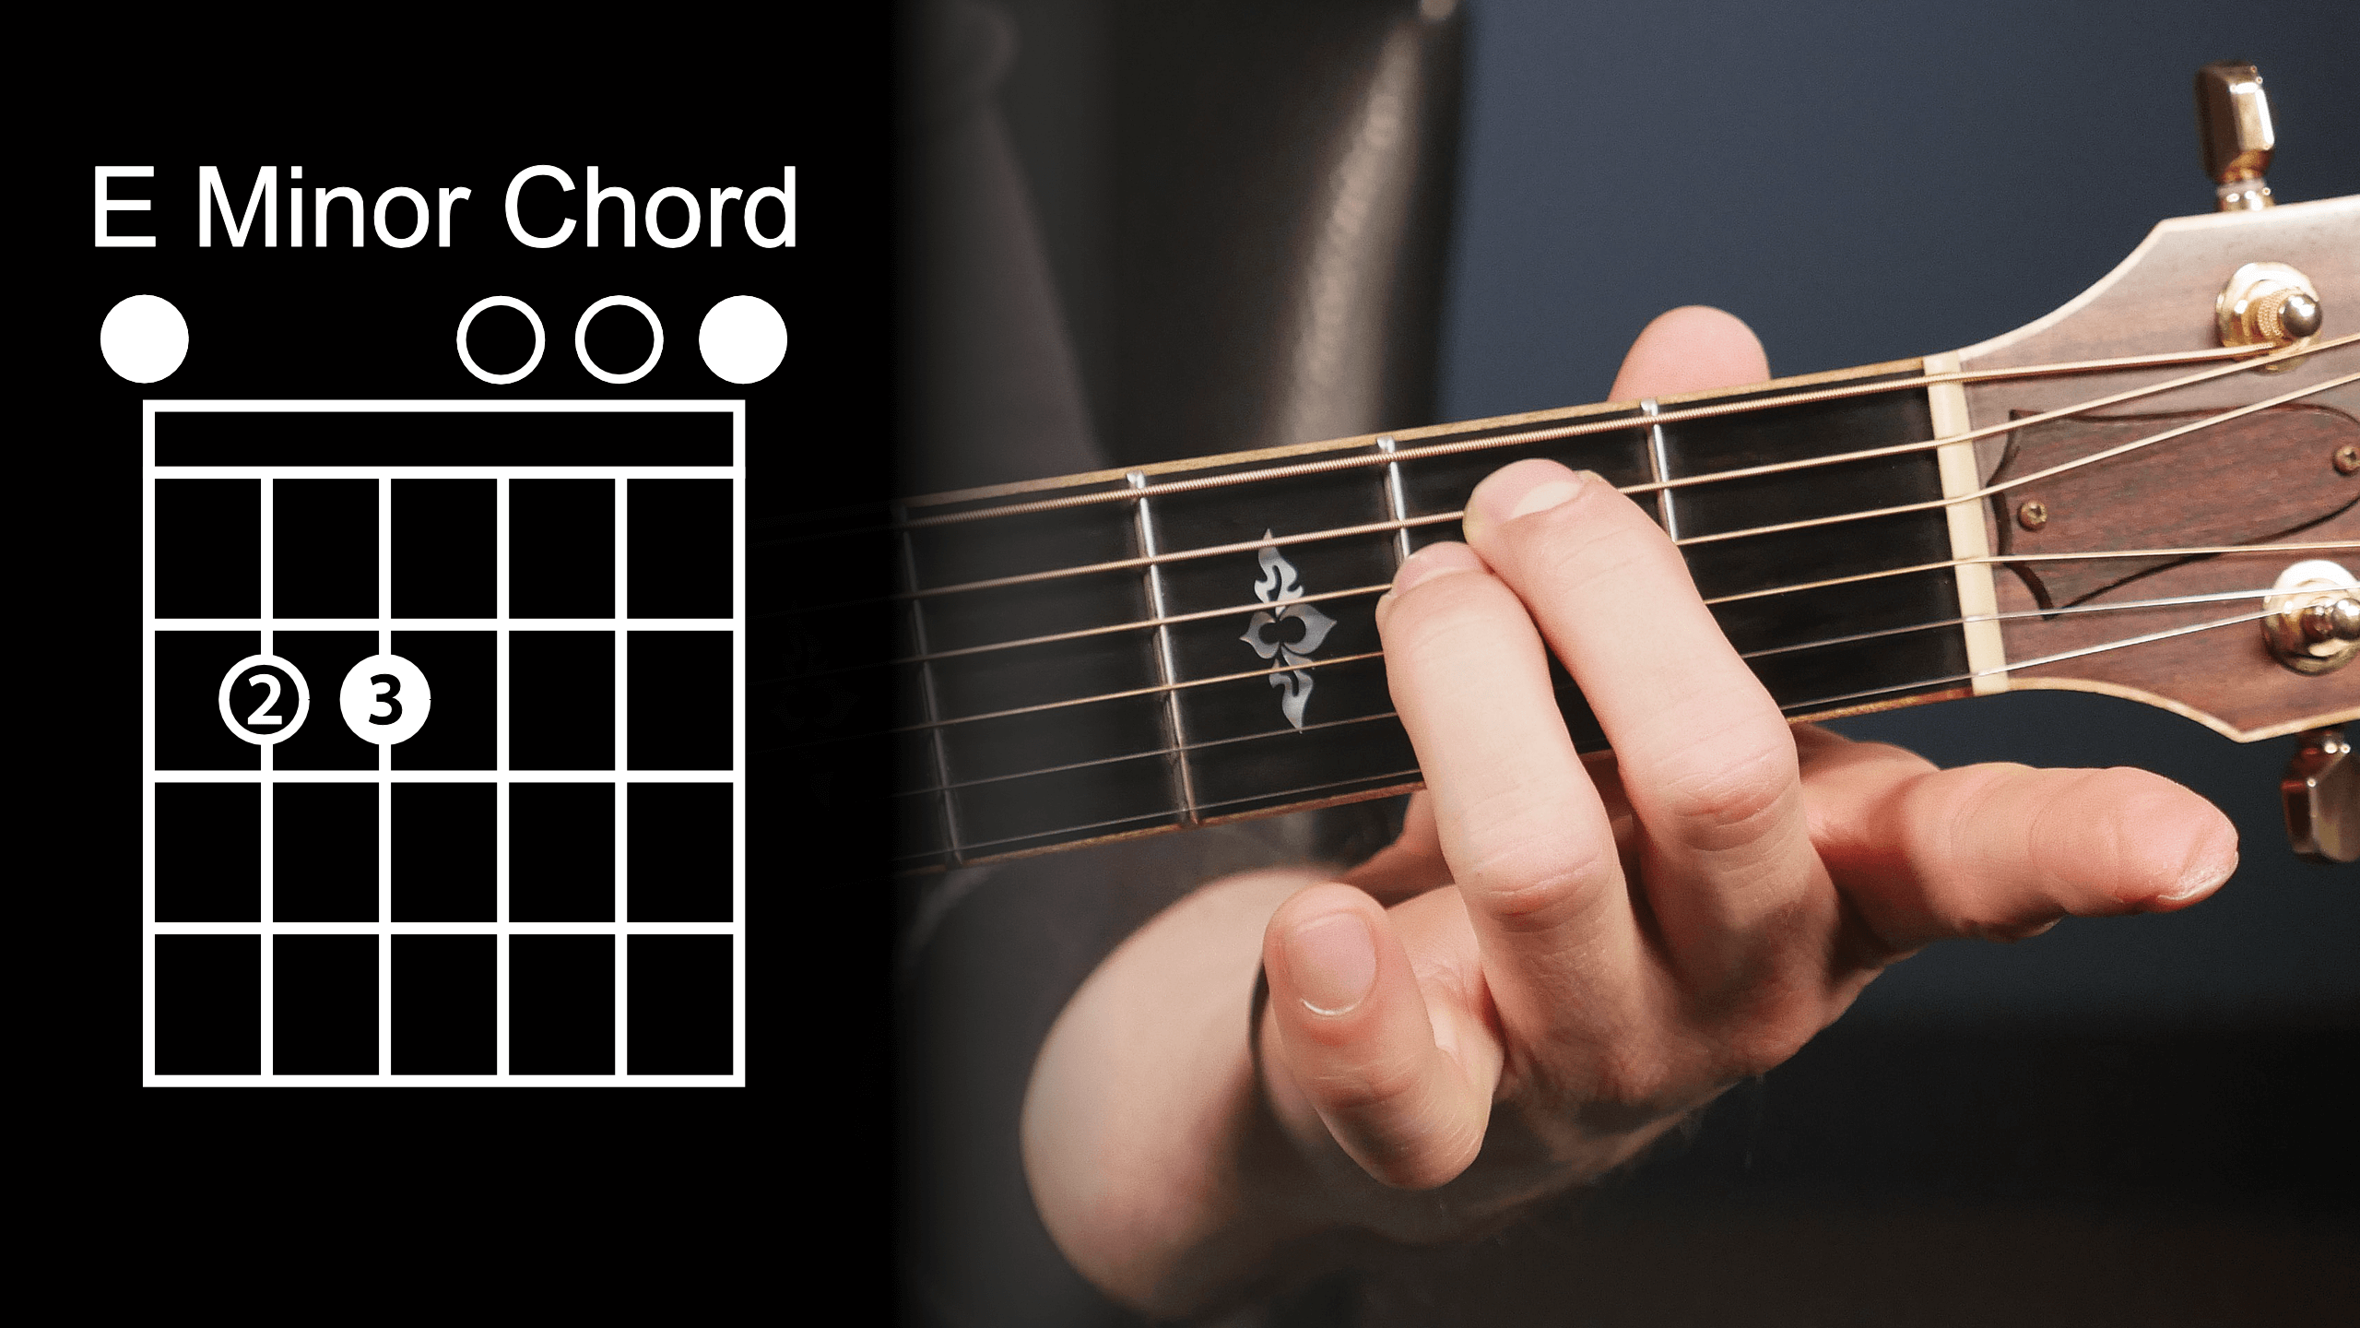
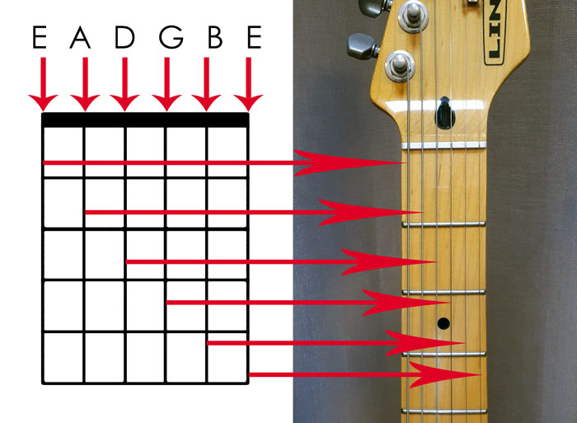
Notes:
Imagine you are just learning guitar. You want to play your favorite song, because that's what playing guitar is all about.
So you Google the song, and find... This
(first animation).
What does this mean? "Em"?
Next, you have to find out what "E minor" actually means, and how to play it.
Guitar songs are made up of chords, which are basically sounds the guitar can make that are part of a song.
To play these chords, you need to put your fingers in just the right positions, which can be very frustrating.
Guitars have metal frets, which are perpendicular to the strings, and determine which note you play.
So you find some chord diagrams
(second animation).
But... there are multiple ways to play a chord? This is all so confusing!
Once you choose which version of the chord to play, you need to get your fingers in the right positions using the diagram.
(third and fourth animations)
Translating this diagram onto the guitar neck is difficult, and you have to look at the neck and diagram to get it right.
This whole process is cumbersome to beginners and results in frustration.

Slide 9
Learning guitar is hard...
Notes:
We believe that beginners struggle due to a lack of gratification and inability to quickly play the songs they want. We hope to solve this problem with an ingenious learning aid.

Slide 10
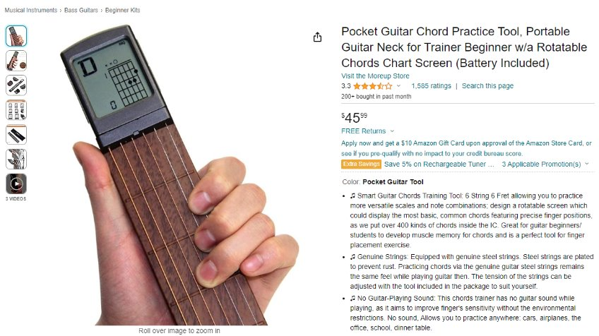
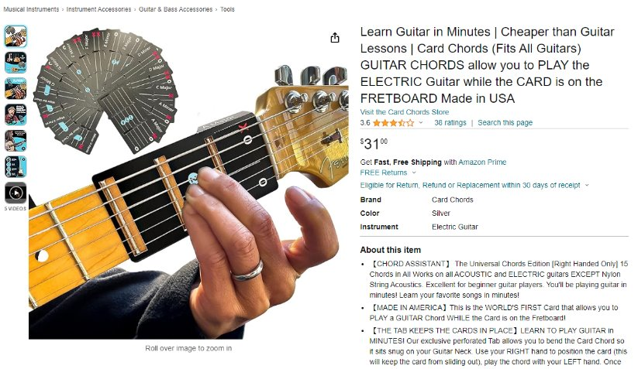
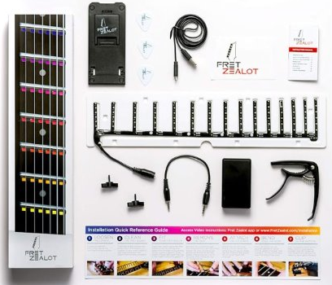
$46
$31
$120
Notes:
Once we knew that a physical aid for learning guitar would be popular, we conducted market research to find existing designs.
(First animation) Some products we found do not attach to the guitar, such as the device in the upper left.
(Second animation) In the upper right, another product we found required attaching paper chord diagrams to the guitar neck.
However, this makes it difficult to switch between multiple chords.
(Third animation) And the product in the bottom center is a device that uses small lights, or LEDs, to display positions for finger placement. The issue with this product is that it requires taking the strings off of the guitar, and using permanent adhesive to attach the device to a guitar. This could damage the guitar, which is not an option.

Slide 11
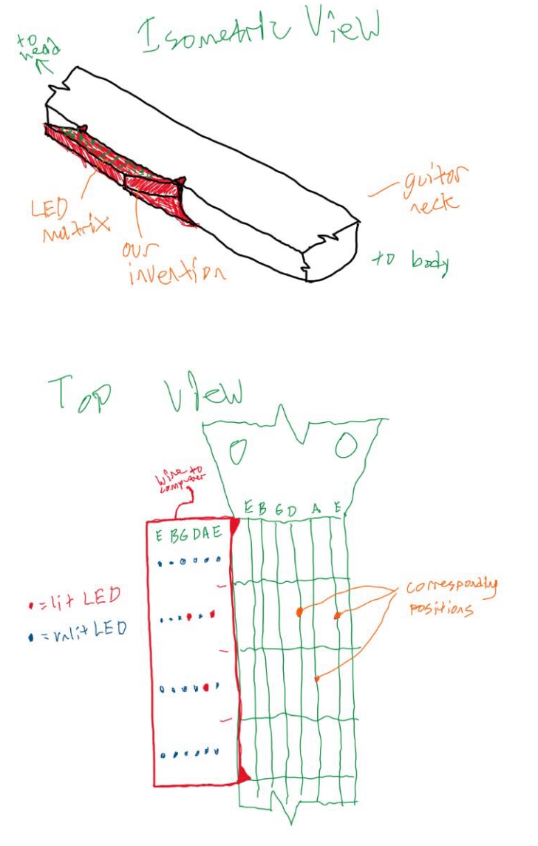
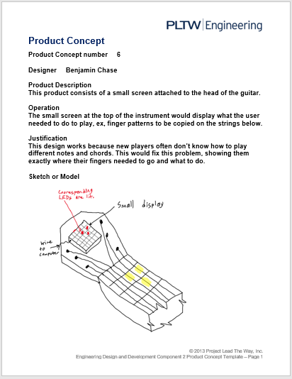
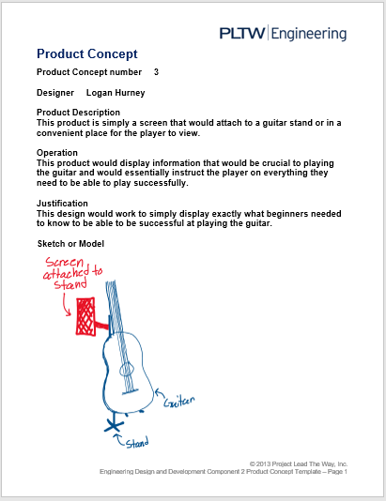
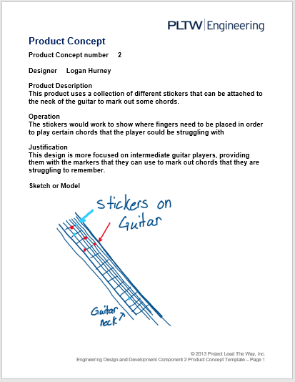
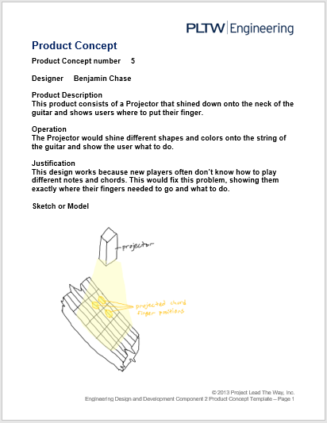
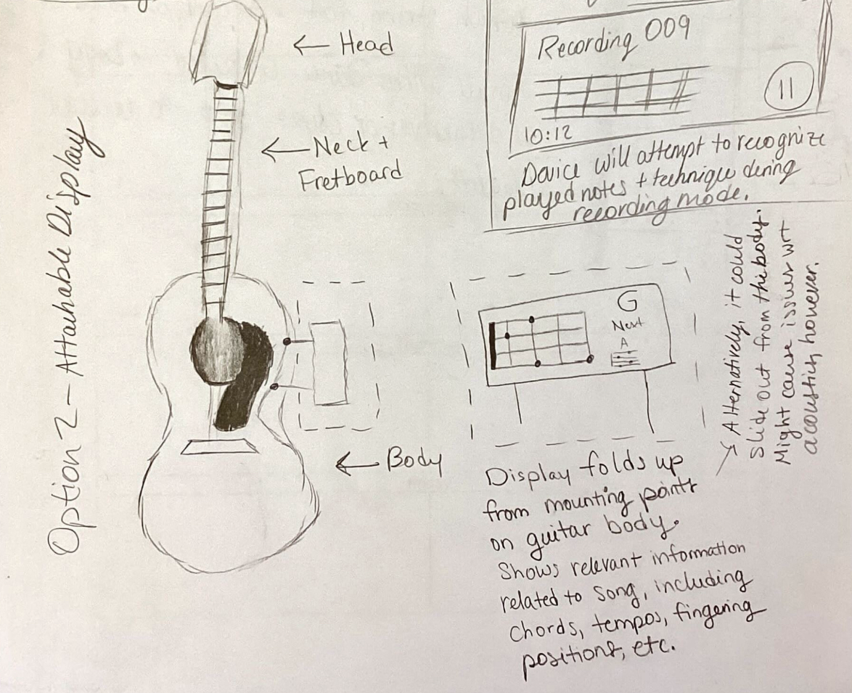
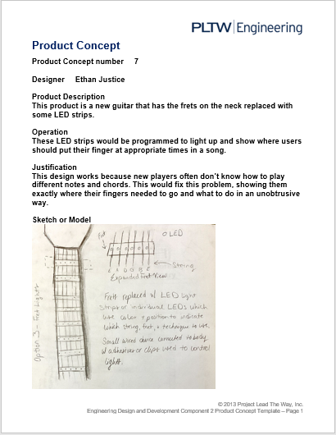
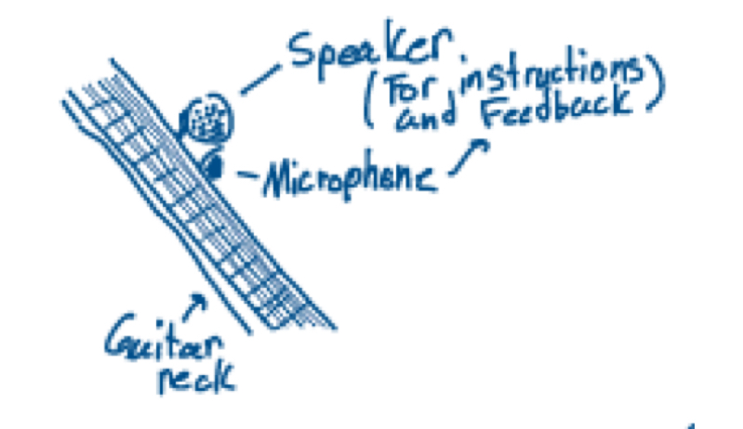
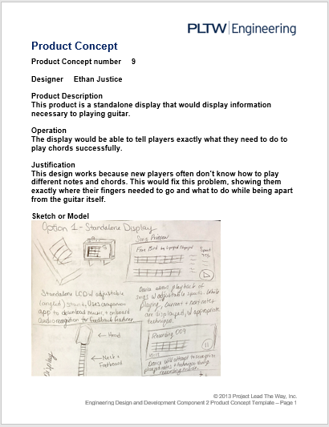
Solutions?
Notes:
(9 animations)
So we made multiple concept sketches for designs that could possibly solve this problem.
We ended up deciding on these 3.
Then, we surveyed 20 individuals as out these Ideas to determine where to go next.

Slide 12
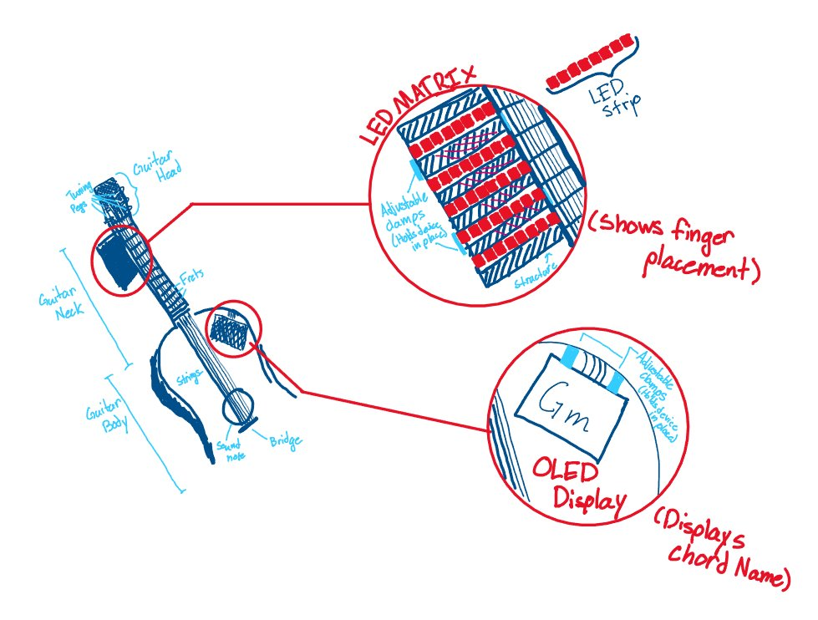
Notes:
So we came up with the "Chordinator," a device that simply clips onto the neck and body of the guitar. The Chordinator does not require any modifications to the guitar, and lets you load songs of your choosing onto it.
But how does this work? (next slide)

Slide 13
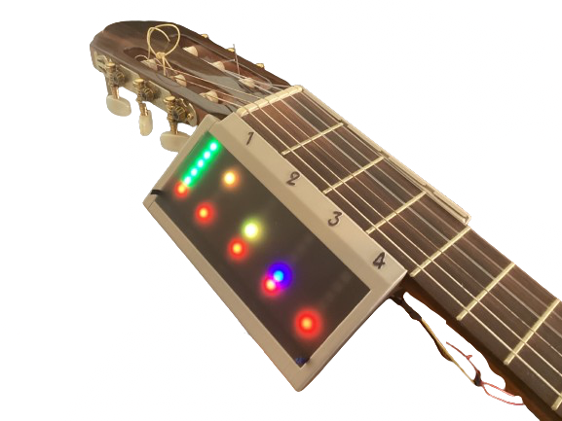
LED Matrix (an array of lights)
Notes:
A matrix of LED lights is attached next to the neck, or top portion, of the guitar. Corresponding lights will light up according necessary finger positions.
The colors on the display represent different fingers to use, and which strings to strum.
(OLED display is on the next slide)

Slide 14
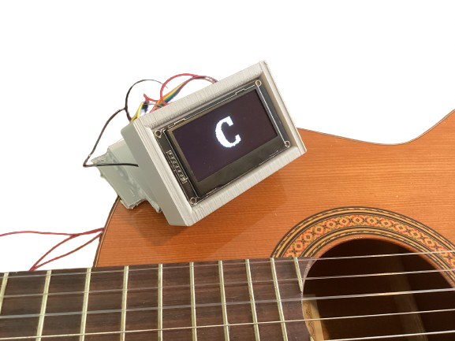
High-Contrast Display
Notes:
Along with this, there is a high-contrast display clipped to the body of the guitar that displays the chord name.
The Chordinator is aimed to take all the frustration out of learning to play guitar, so you can get right to learning chords without wondering about chord diagrams.

Slide 15
Demonstration
“Shake It Off” – Taylor Swift
Notes:
(DEMONSTRATION)

Slide 16
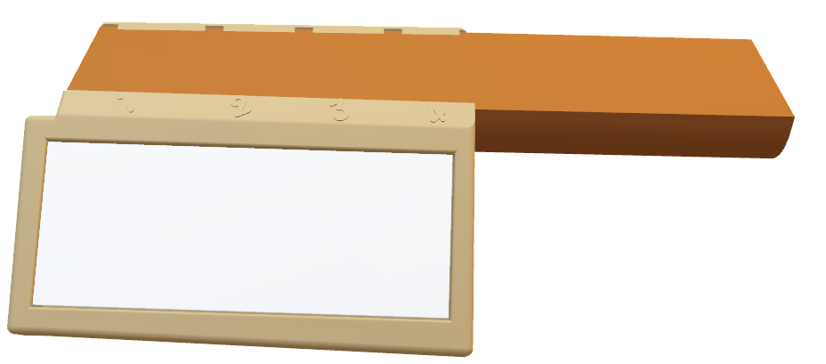
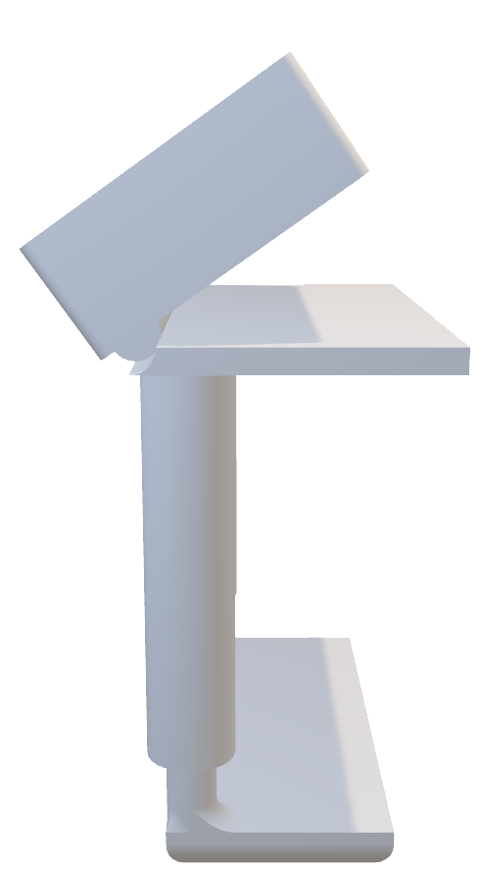
CAD Development
Body Attachment
Neck Attachment
Notes:
We used Computer Aided Design (CAD) software called Autodesk Fusion 360 to design the case of the Chordinator, and used a 3D printer to accurately and easily produce our design.

Slide 17

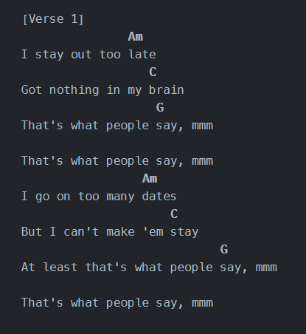
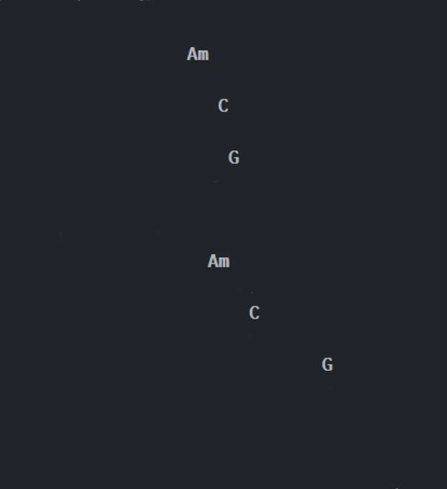
Software Development
Python logo
Notes:
On the software side of the Chordinator, a small computer called a Raspberry Pi uses data from a popular guitar song website called Ultimate Guitar. This process is called "web scraping," and gives the Chordinator access to over 500,000 songs. This data is then interpreted as chord names which are then converted to finger positions to be shown on the LED lights. Also, the chord name is shown on the display attached to the guitar body.
For all of this to work, a powerful programming language called "Python" was used to program the computer with a custom-built program for getting song data. All of the software is free and open-source, so no sneaky payments or monthly subscriptions are necessary.

Slide 18
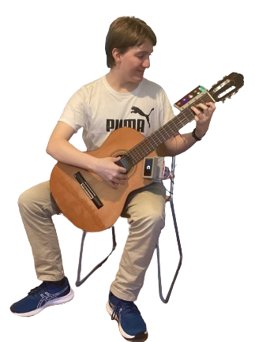
Project in Review
Notes:
During the course of this project, we learned how to decide upon a design based on user data and design an effective prototype.
We also learned how to redesign and incorporate tolerances, and program a web scraper.

Slide 19
Thank you
Notes:
We would like to take a moment to thank everyone who supported us along the way.
Thank you to
Our absolutely amazing engineering teacher, Mrs. Zienty, for providing us the knowledge, support, and resources necessary to complete this project.
Mrs. Sangwan and Mrs. Gallo for teaching us about other fields of engineering and teaching us new skills.
Our wonderful mentor, Mr. Czar Domingo, who is an Aerospace Technology Software Engineer at NASA Wallops Flight Facility. He helped to advise us on our project. With his experience in software validation, he helped to find possible issues such as viewing angle and cable management before they could occur.
Mr. Hughes, a guitar teacher at Stephen Decatur Middle School for distributing the survey among his students.
All of the survey respondents.

Slide 20
Questions?
Notes:
Questions?

